Slide 1


R.F. STAT 642 Kaggle Competition
March 2023
Wang, Ruifeng
MS in Business Analytics
rw856@drexel.edu

Slide 2
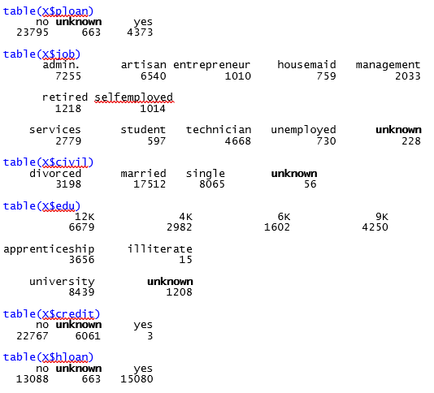
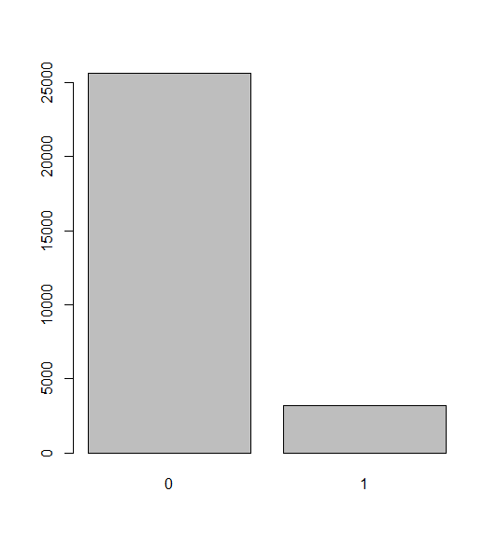
The Dataset
• There are 28831 rows & 21 columns in training set, and 12357 rows & 20 columns in test set.
• The data in client information and target variable are imblanced.
• Unknown data can be recognized as NA, which decrease the predictive accuracy of algorithms.

Slide 3
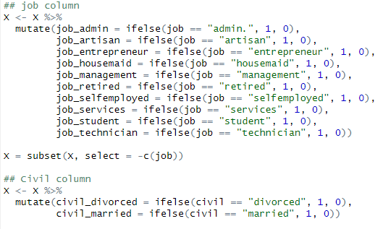
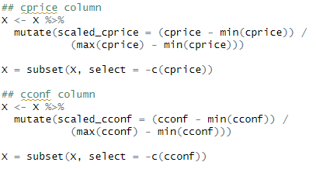
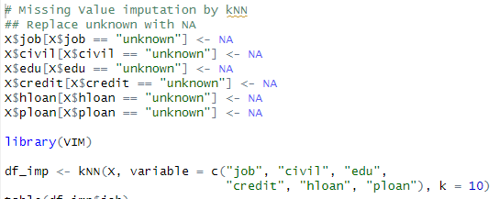
Data Preparation
One Hot Encoding
• Dropping id column.
• Use kNN algorithm to impute NA(unknown).
• Using one hot encoding to convert categorical
variables into binary vectors.
• Standarize Numeric variables from 0 to 1.
• Split training set into two parts to evaluate model.
kNN Imputation
Data Standardization

Slide 4
Modeling: XGBoost
XGBoost is an optimized distributed gradient boosting library designed to be highly efficient, flexible and portable. It is a commonly used algorithms in machine learning, especially for classification.
This model can use parallel computing techniques to speed up the computational requirements. The more cores a computer have, the shorter time to require when run this model. In addition, XGBoost supports regularization in the form of both ridge and lasso, which can lead to further improvements.
Reference:
[1] XGBoost Documentation — xgboost 1.7.4 documentation
[2] Tutorial Week 10

Slide 5
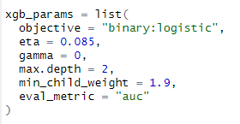
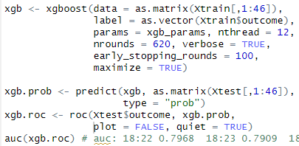
Model Evaluation
• Using AUC to evaluate the model performance
• Tuning parameters to improve model performance.
• Retrain model by whole training set, output the result and submit.

Slide 6
Managerial Implication
• Based on descriptive analysis and my observation, I found following insight:
1. Artisans are less likely to open an account, but retired people are more likely to open an account.
2. There are weak correlation between ages and target variable.
3. Change of employees (both ‘employee’ column and ‘employment’) will affect the consuming behaviors, which result in the decision on whether open an account.
4. As financial indicators, ‘cprice’, ‘cconf’ and ‘euri3’ reflect the economic condition, which also affect the number of potential customers.

